Slide 1
VOICE OPERATED PRESCRIPTION
MANAGER AND MEDICINE DISPENSER

Slide 2

Department of Information Science and Engineering Jyothy Institute of Technology
Tataguni, Bengaluru-560082 2019-20
PRESENTED BY:
NOOPURA.M.S
PALLAVI.S
RAJESHWARI.B
PROJECT GUIDE:
ABHISHEK . K
Asst. Professor
Dept. Of ISE

Slide 3
Contents
Aim
Abstract
Literature Survey
System Requirement Specification
Block Diagram
Methodology
Flow chart
Snapshots
Outcome
Advantages
Conclusion and future Enhancement

Slide 4
AIM
To build an Smart and Assured Medicine Dispensing Unit which would be effective in intimating an user to take tablets at the prescribed period by conveying a voice message.
In turn the system must be able to send an message to the preferred number by sensing the current condition of the box.

Slide 5
Abstract
In day today busy life people are forgetting many things especially with their medication routine.
These type of situations are most commonly seen in aged and blind ones, sometimes even with the common people due to their age factor and inefficiency .
Following these kinds of practice might leads to a slow recovery and in some situation it might leads to an life threat .
Thus in order to overcome this problem we are developing an Voice based Medicine Dispensing unit .
This can be set to function as intimating an user through voice and dispensing the tablet out of the box in a kind of automated way . And the same been sensed and sent to the concerned one through message .

Slide 6
Literature Survey
The idea of implementation of Voice based Medicine Dispensing unit from the source to the present is been carried out in an different developmental stages from year to year .
The brief justification is as below.
1. Medicine Remainder and Monitoring System for Secure Health Using IOT
Samir V.Zanjal , Girish R.Talmale.
Access article under the CC BY-NC-ND ,2015
Distant monitoring
Review the technology of how well home health care system among them a medicine reminder system and improvement regarding authentication model, medical sensing, communication and analytics device can be prepared with a low cost in order to sense the patients physical condition.

Slide 7
2. Smart Medicine Box
Viral Shah , Jigar Shah, Nilesh Singhal
Imperial Journal of Interdisciplinary Research
Vol-2,Issue-5,2016
Smart Medicine Kit which tracks number of dosage need to take at particular time for senior citizen patient.
For this developing an box like storage to hold the pills which needs an regular refilling and an reminder to beep at particular time when the medicine needs to be taken .
3. Smart Medicine Remainder Box
Sanjay Bhati,Harshid Soni,Parth Vyas.
International Journal of Science Technology and Engineering
Vol-3,issue-10,2017
Smart medicine kit with a sensing capability which identifies if the patient tries to switch of the beep or opening /closing at wrong time.

Slide 8
Implementation of real time clock which senses whether the patient has taken medicine or not , thus patient can’t postpone the time on which they needs to take the pill.
4. Smart Medicine Kit
Anjana Bharadwaj,Upasana ,RanjeetaYadav.
IOSR Journal ,ISSN(e) :2250-3021,ISSN(p):2278-8719
Vol-8,issue-7,2018
A Smart Medicine Kit with a panic button in case of emergency and Sub boxes to store the pills.
Along a with a beep sound displaying the message and the same would be heard by translating it into speech by the E-speak software.

Slide 9
Software Requirement Specification
Introduction:
1.1.purpose
Our project’s main aim is to make a Smart Medicine box for those users who regularly take medicines.
For elderly people or blind people who had problem in keeping track of their medicines which might cause certain health issues which can be resolved with this medicine kit.
1.2.Intended use
This kit is generally applicable for all generation people who regularly take medicines and also mainly for old people and blind ones, where the voice enabling helps them to take the pills.

Slide 10
1.3.Scope
The smart medicine box which keeps track of the dosage and duration between each consumption and provides an intimation through voice message.
1.4.Definition and Acronyms
The main definition of voice based dispenser is to remind and help them to follow the prescribed routine.
The acronym of the medicine kit is ‘V-med’.

Slide 11
Overall Description
2.1.Overall Description
There are some medicine boxes that already has been implemented, but those are static which are not automatic.
The main difference in the implementation of our project is, we are using IOT and also voice module which has more smartness and uses in it.
2.2.User needs
In general this kit is useful for all generation.
It is very useful and needful for the old people and blind people, where the kit will guide the people to take the tablets according to prescription through voice .

Slide 12
System Feature and Requirement
3.1.Hardware Requirement
Rasberry pi.
External power supply is required (normally 5volts).
3 Boxes which opens according to the prescribed time using DC motor.
H bridge motor driver.
3.2.Software Requirement
Python is used for coding.
The code which processes the functionality of hardware and software integrity .

Slide 13
3.3.Communication Interfaces
Our project is IOT based, so internet is required.
Voice feature – To communicate with the kit user.

Slide 14
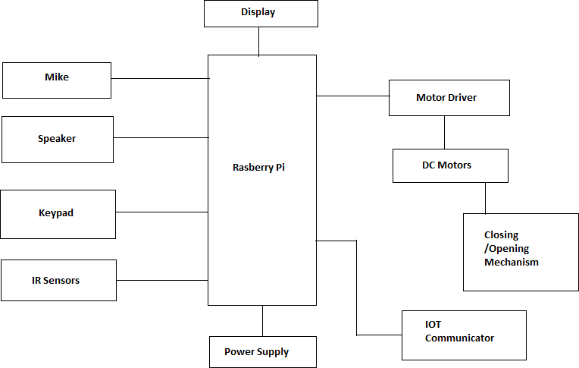
BLOCK DIAGRAM:

Slide 15
Methodology
The Medicine Dispensing unit intimates the user through an voice message at particular time .
The user has to confirm their presence by in turn conveying some message and considered it as input.
The unit would dispense the tablets present in the first box by providing some message.
The IR Sensor will sense the box after few seconds of intimation to sends message to the care taker .
If IR Sensor could still sense the presence of tablet , the box remains opened until taken out.
And is practical for different durations according to the requirements .

Slide 16
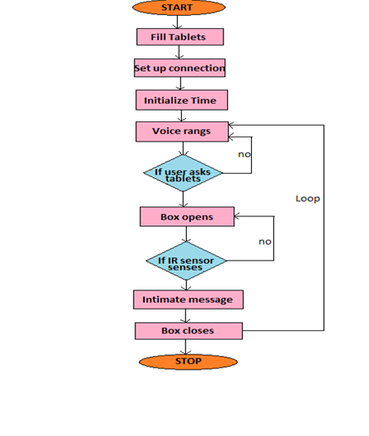
Flow Chart

Slide 17
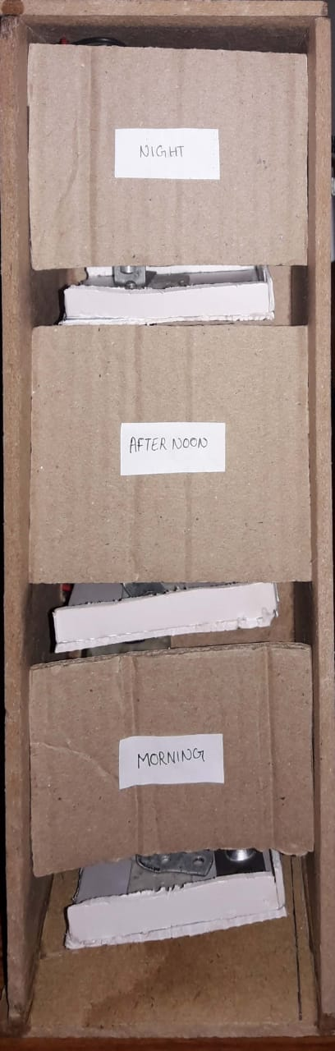
Snapshots:

Slide 18
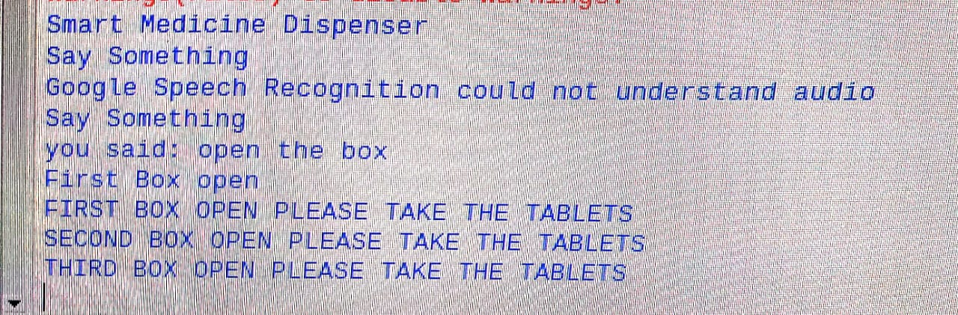
Figure : The output that we listen
The speaker we are using as for now is the earphone. The speech that could be listen through the microphone will also be displayed in the console.

Slide 19
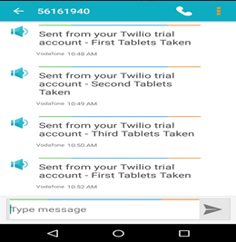
Figure : The intimating message sent to the caretaker

Slide 20
Outcome
The proposed system was tested around while taking into account different kinds and forms of pills weighting less than 500mg.
Various dosage and timing schedules were considered and the system was tested for several hours and some days .
Results show that about 85% were satisfied .
At the end , concerning the ease of use , more than 90% considered that this medicine box is simple when being used .Establishing the connection.
Notes:
FUTURE TASK

Slide 21
Advantages
Accurate result:
Intimation message will be conveyed at the proper time which is set by user previously.
Easy to maintain:
It needs less Maintenance. It is one time investment afterwards it can be used continuously.
User Friendly:
The concerned person or the User can set time of medicine by them self . And kit provides message through voice and user can interact with the kit .
Reliability :
Good in quality and performance ; able to be trusted for users.

Slide 22
Conclusion and Future Enhancement
Apart from the requirement of internet , the system can be set anywhere to work functional.
Alexa features can be included for the betterment of options in terms of conversations.
Image sensing sensors can be incorporated to detect the actual action of the user.

Slide 23
References
[1] S.Haung ,H.chang ,G.Chen .The intelligent pill box,S.S Al-majeed.Home Telehealth by internet of things.
[2] IEEE Sens .J.,vol.15, no .c,pp.1-1;2016 , Russel,S.,Norvig,P.(2013) .Artificial Intelligence:
[3] http://www.engineersgarage.com/contribution/medicine-reminder-using-ardino?
https://www.instructables.com/id/12C-LCD-Controller-the -easy-way/
[4] IOT based healthcare kit , M.roman ,C.hess “Gaia”, J.P Sousa and D .Garlan ,“Aura”. , SAP Corporate Research : http://www.sapinfo.net/public/de/printout.php4/article/Article 49043df892f123d88/en.

Slide 24
Thank You
Notes:
Thank You

